Slide 1
BJT-Differential Amplifier

Slide 2
Two matched transistors, Q1 and Q2, whose emitters are joined together and biased by a constant-current source I.
Q1 and Q2 should never enter saturation.
The basic BJT differential-pair configuration

Slide 3
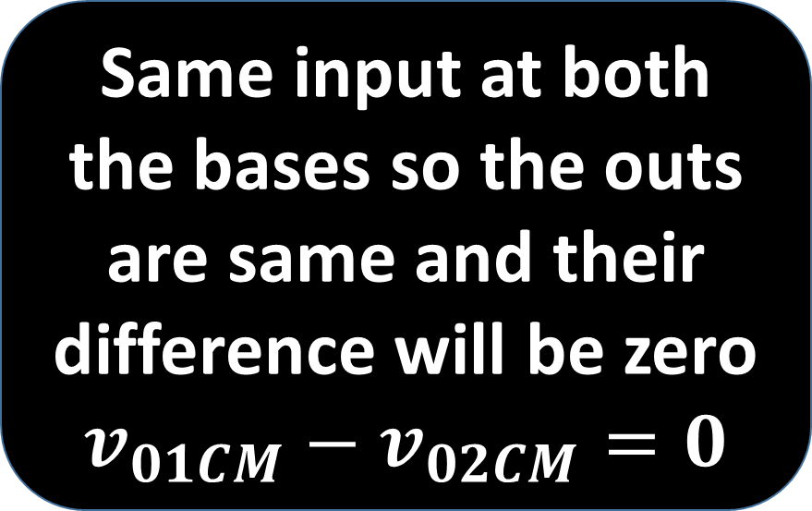
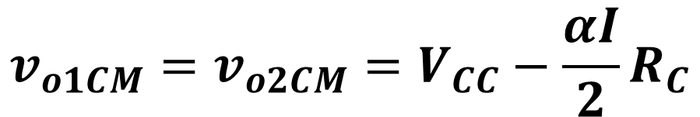
Basic Operation
$$v_{o1CM}=v_{o2CM}=V_{CC}−\frac{αI}{2}R_{C}$$
Same input at both the bases so the outs are same and their difference will be zero
$$v_{01CM}−v_{02CM}=0$$
Differential pair with a common-mode input voltage VCM

Slide 4
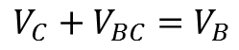
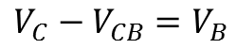
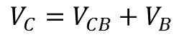
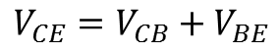
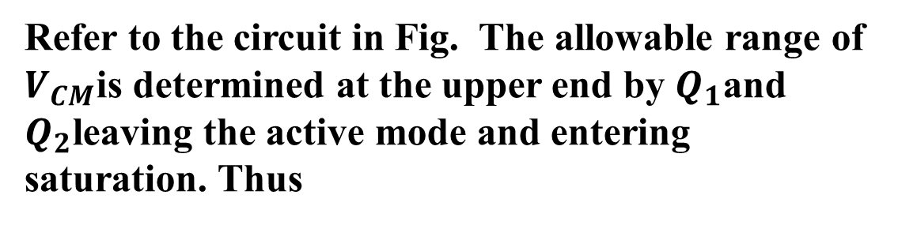
Refer to the circuit in Fig. The allowable range of $V_{CM}$is determined at the upper end by $Q_{1}$and $Q_{2}$leaving the active mode and entering saturation. Thus
$$V_{CE}=V_{CB}+V_{BE}$$
$$V_{C}=V_{CB}+V_{B}$$
$$V_{C}−V_{CB}=V_{B}$$
$$V_{C}+V_{BC}=V_{B}$$

Slide 5
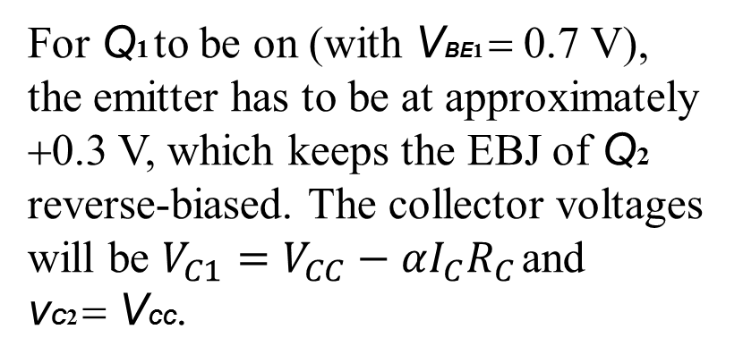
Large differential input
For Q1 to be on (with VBE1 = 0.7 V), the emitter has to be at approximately +0.3 V, which keeps the EBJ of Q2 reverse-biased. The collector voltages will be $V_{C1}=V_{CC}−αI_{C}R_{C}$ and
vC2 = VCC.
One “ON” the other “OFF” and vice versa
Let us now change vB1 to -1 V . Again with some reasoning it can be seen that Q1 will turn off, and Q2 will carry all the current I. The common emitter will be at - 0.7 V, which means that the EBJ of Q1 will be reverse biased by 0.3 V.

Slide 6
Derivation of Large signal Equation

Slide 7
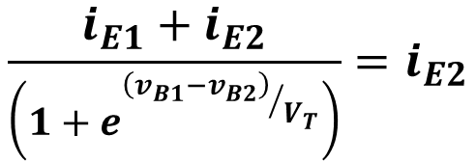
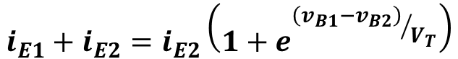
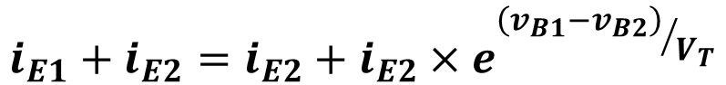
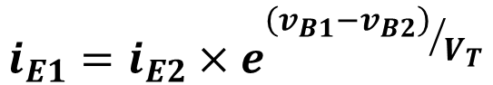
If we denote the voltage at the common emitter by vE and neglecting the Early effect, the exponential relationship applied to each of the two transistors may be written
$$i_{E1}+i_{E2}=i_{E2}\left(1+e^{{\left(v_{B1}−v_{B2}\right)}/{V_{T}}}\right)$$
$$\frac{i_{E1}+i_{E2}}{\left(1+e^{{\left(v_{B1}−v_{B2}\right)}/{V_{T}}}\right)}=i_{E2}$$
$$i_{E1}=i_{E2}×e^{{\left(v_{B1}−v_{B2}\right)}/{V_{T}}}$$
$$i_{E1}+i_{E2}={i_{E2}+i}_{E2}×e^{{\left(v_{B1}−v_{B2}\right)}/{V_{T}}}$$

Slide 8
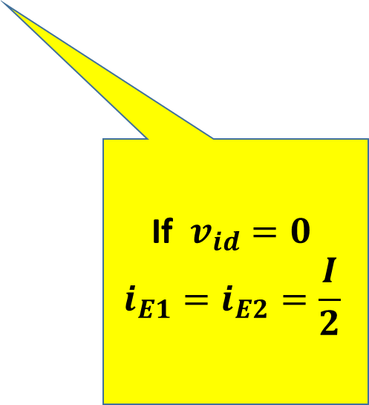
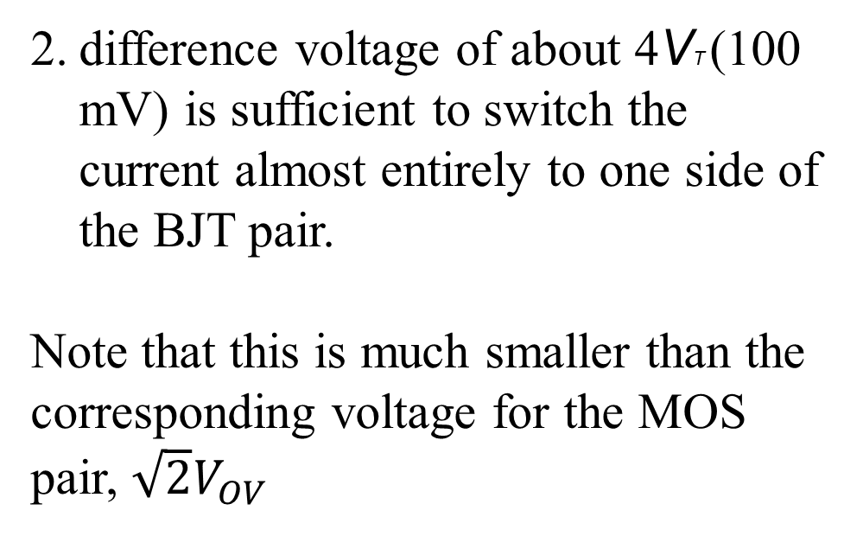
General conclusions
First, note that the amplifier responds only to the difference voltage vid
difference voltage of about 4VT (100 mV) is sufficient to switch the current almost entirely to one side of the BJT pair.
Note that this is much smaller than the corresponding voltage for the MOS pair, $\sqrt{2}V_{OV}$
If $v_{id}=0$
$$i_{E1}=i_{E2}=\frac{I}{2}$$

Slide 9
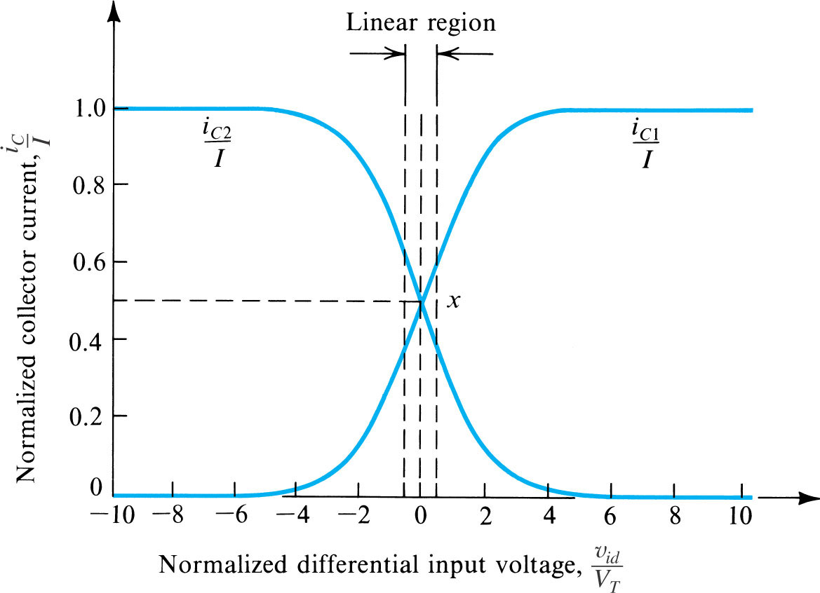
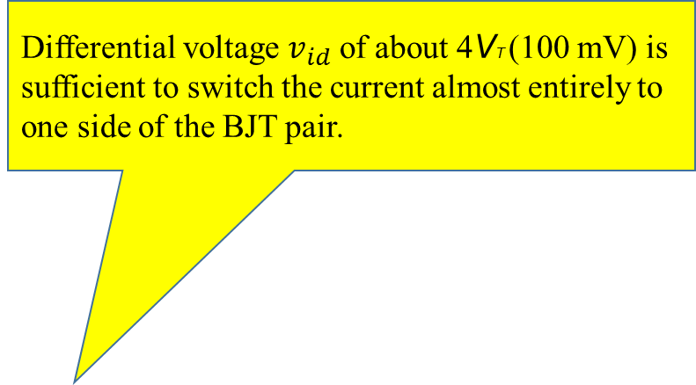
Differential voltage $v_{id}$ of about 4VT (100 mV) is sufficient to switch the current almost entirely to one side of the BJT pair.

Slide 10
Including two equal resistances Re in series with the emitters of Q1 and Q2, as shown in Fig. The resulting transfer characteristics for three different values of Re are sketched . Observe that expansion of the linear range is obtained at the expense of reduced Gm and hence reduced gain.

Slide 11
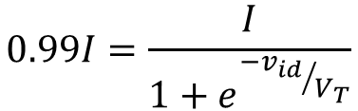
$$0.99I=\frac{I}{1+e^{{−v_{id}}/{V_{T}}}}$$

Slide 12
Small Signal Operations

Slide 13
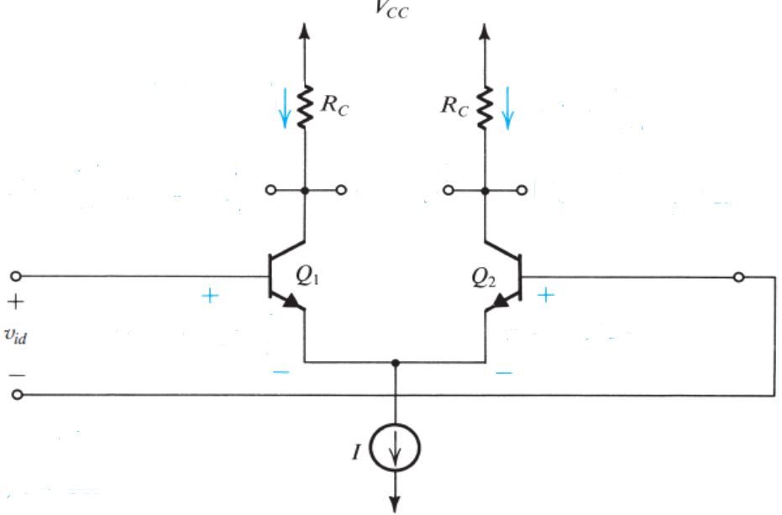
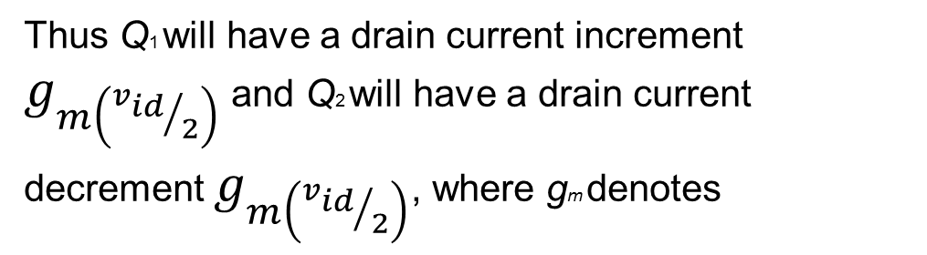
The Collector Currents When $v_{id}$ is Applied
Multiplying the numerator and the denominator of the right-hand side of Eq by

Slide 14
The small signal current
Similarly

Slide 15
Small-Signal Operation
DC +ac currents
DC voltage
ac voltage
Diff output voltage

Slide 16
An alternate view point

Slide 17
Common Mode input resistance

Slide 19
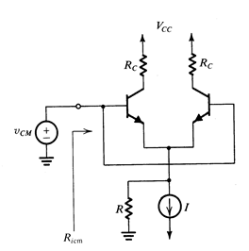
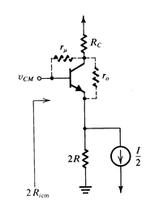
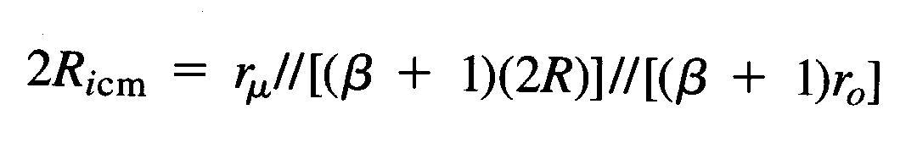
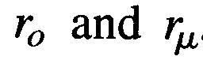
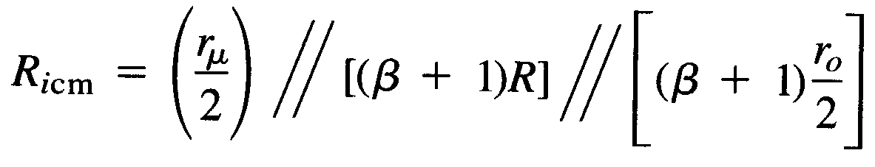
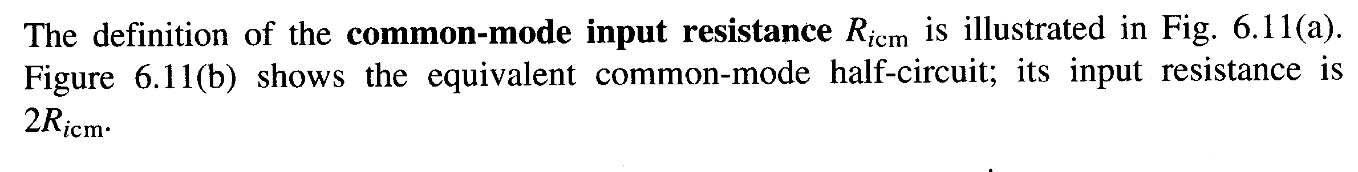
Input CM resistance is large so we must take into account
CM gain is small, so assume 0V at collector then r₀ appears in
parallel with 2R in the emitter and r_{u} appears between input
and ground.
“emitter
reflectance
rule”

Slide 20
Differential Input Resistance

Slide 21
DC part
AC part

Slide 22
Differential Voltage & Voltage Gain

Slide 24
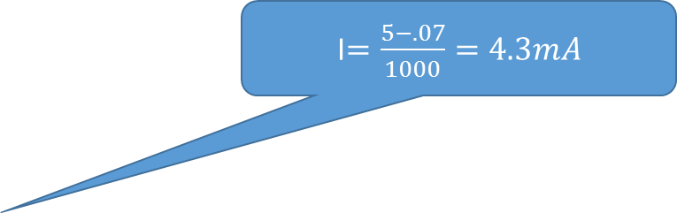
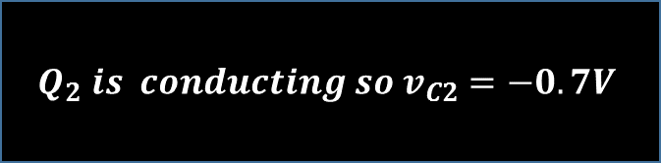
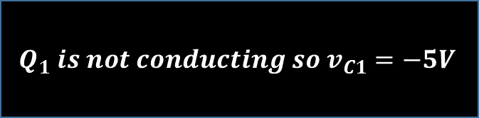
0.7V
I$=\frac{5−.07}{1000}=4.3mA$
$$Q_{1} is not conducting so v_{C1}=−5V$$
$$Q_{2} is conducting so v_{C2}=−0.7V$$
0 Current flowing through this
Whole of Ie flowing through this channel

Slide 25
The Differential Half-Circuit

Slide 29
In evaluating the model parameters
rπ , gm, and ro, we must recall that the half-circuit is biased at I/2.

Slide 31
Section A

Slide 33
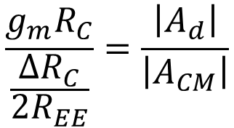
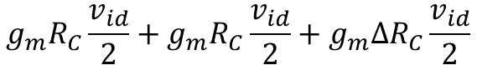
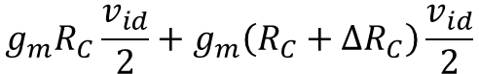
Common-Mode Gain and CMRR
When There is slight difference between the two collector resistance
$$g_{m}R_{C}\frac{v_{id}}{2}+g_{m}\left(R_{C}+∆R_{C}\right)\frac{v_{id}}{2}$$
0
$$g_{m}R_{C}\frac{v_{id}}{2}+g_{m}R_{C}\frac{v_{id}}{2}+g_{m}∆R_{C}\frac{v_{id}}{2}$$
$$\frac{g_{m}R_{C}}{\frac{∆R_{C}}{2R_{EE}}}=\frac{\left|A_{d}\right|}{\left|A_{CM}\right|}$$

Slide 38
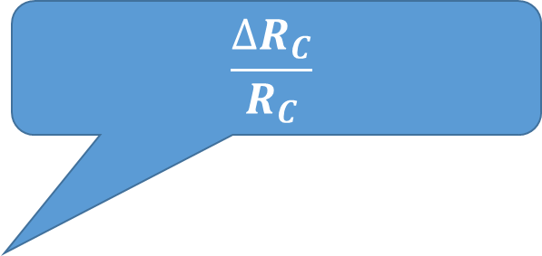

$$\frac{∆R_{C}}{R_{C}}$$
$$R_{E}+r_{e}$$

Slide 41
Lecture 2

Slide 42
Other Non-linearity

Slide 43
Input Offset Voltage of the MOS Differential Pair
Consider the basic MOS differential amplifier with both inputs grounded. If the two sides of the differential pair were perfectly matched (i.e., Q1 and Q2 identical and RD1 = RD2 = RD), then current I would split equally between Q1 and Q2, and Vout would be zero.
But practical circuits exhibit mismatches that result in a dc output voltage Vout even with both inputs grounded. We call VO the output dc offset voltage. More commonly, we divide VO by the differential gain of the amplifier, Ad, to obtain a quantity known as the input offset voltage, VOS,

Slide 44
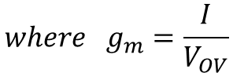
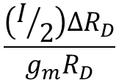
We can see that if we apply a voltage –VOS between the input terminals of the differential amplifier, then the output voltage will be reduced to zero . This observation gives rise to the usual definition of the input offset voltage
The corresponding input offset voltage is obtained by dividing VO by the gain gmRD and substituting for gm . The result is
$$\frac{\left(I/2\right)∆R_{D}}{g_{m}R_{D}}$$
$${where g}_{m}=\frac{I}{V_{OV}}$$

Slide 46
MOS Vos
BJT Vos

Slide 47
Multi-stage Amplifier

Slide 48
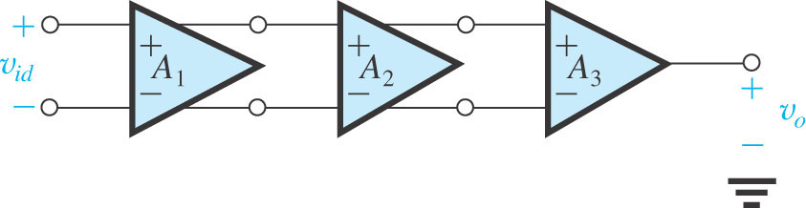

Slide 49
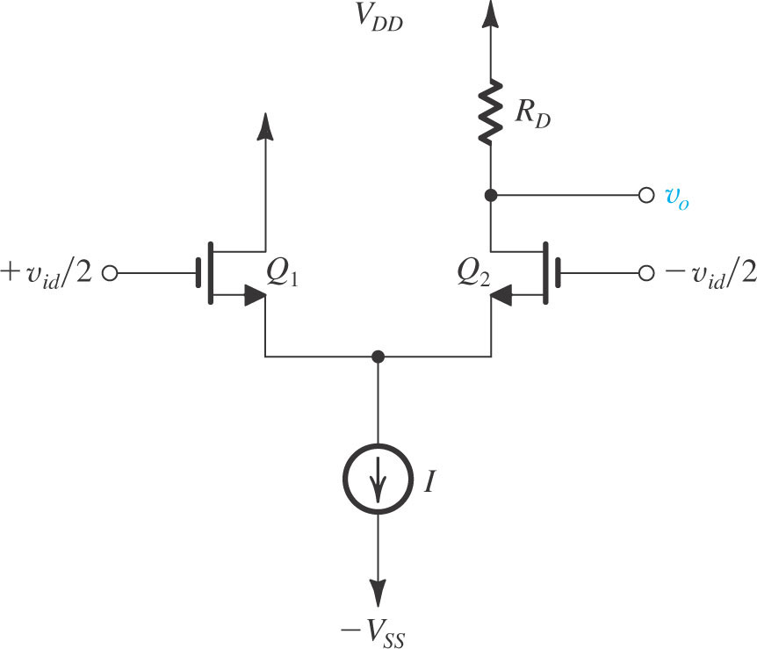
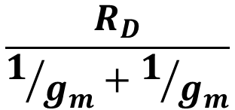
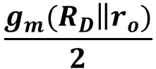
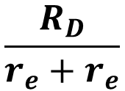
Most basic approach for differential-to-single-ended conversion. It consists of simply ignoring the drain current signal of Q1 and eliminating its drain resistor altogether, and taking the output between the drain of Q2 and ground.
The obvious drawback of this scheme is that we lose a factor of 2 (or 6 dB) in gain as a result of “wasting” the drain signal current of Q1. A much better approach would be to find a way of utilizing the drain-current signal of Q1
$$\frac{R_{D}}{1/{g_{m}}+1/{g_{m}}}$$
$$\frac{R_{D}}{r_{e}+r_{e}}$$
$$\frac{g_{m}{(R}_{D}\left\|r_{o})\right.}{2}$$

Slide 50
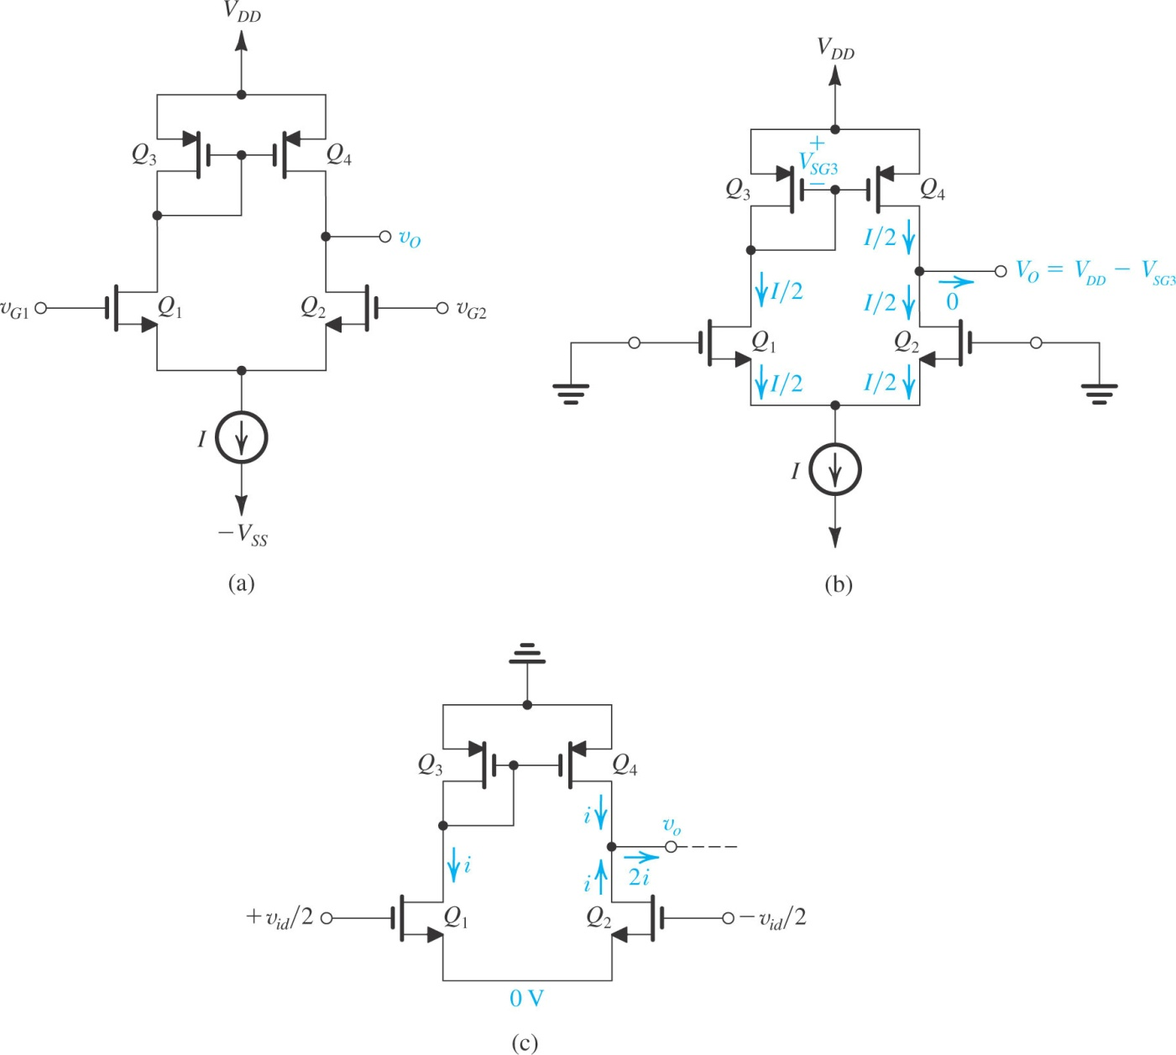
Differential Amplifier with Active Load

Slide 51
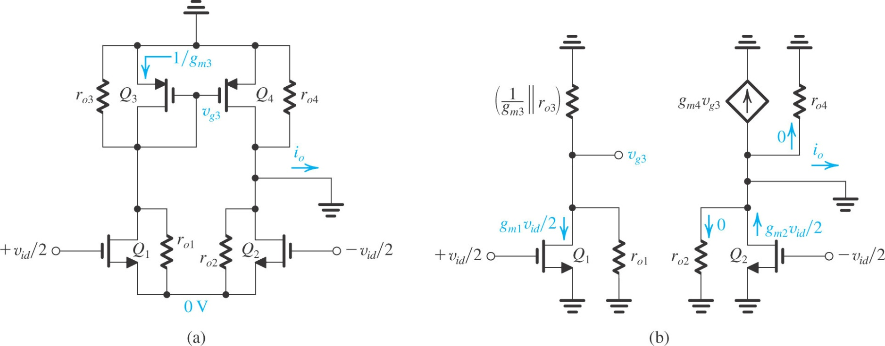

Slide 53
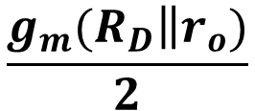
Previous
$$\frac{g_{m}{(R}_{D}\left\|r_{o})\right.}{2}$$

Slide 54
Multistage Amplifiers

Slide 56
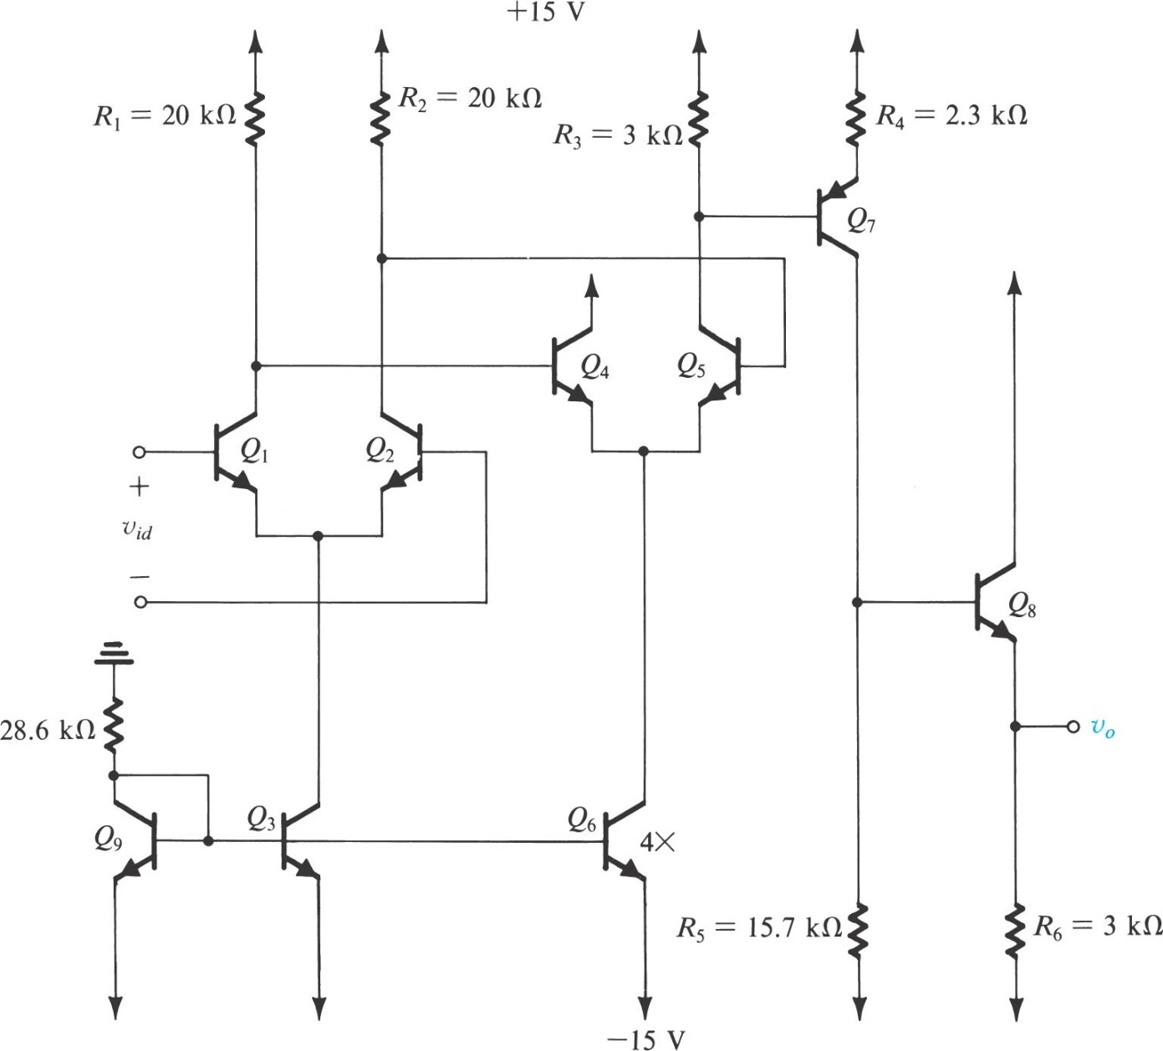
As the dc biasing current and the dc voltage are not given we start our analysis of the circuit by first finding these values with the

Slide 57
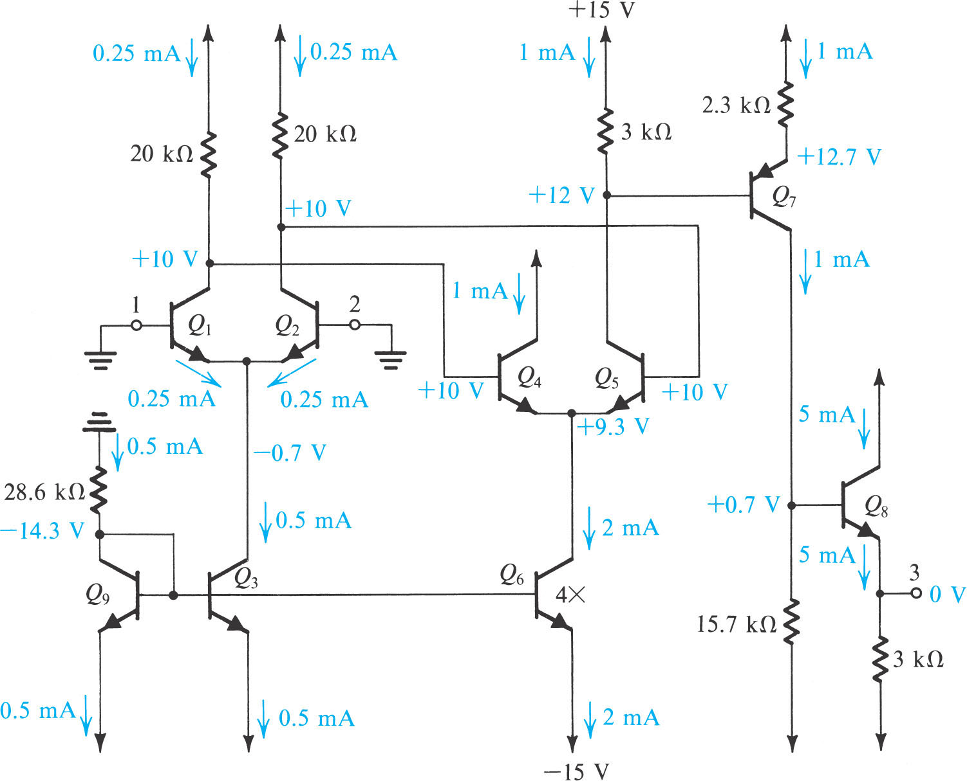

Slide 58
Gain of First Stage

Slide 59
Gain of 2nd Stage

Slide 60
Gain of 3rd Stage

Slide 61
Gain of the last Stage
High Input
Low output

Slide 62
Second Method of evaluating the multistage amplifier circuit

Slide 63
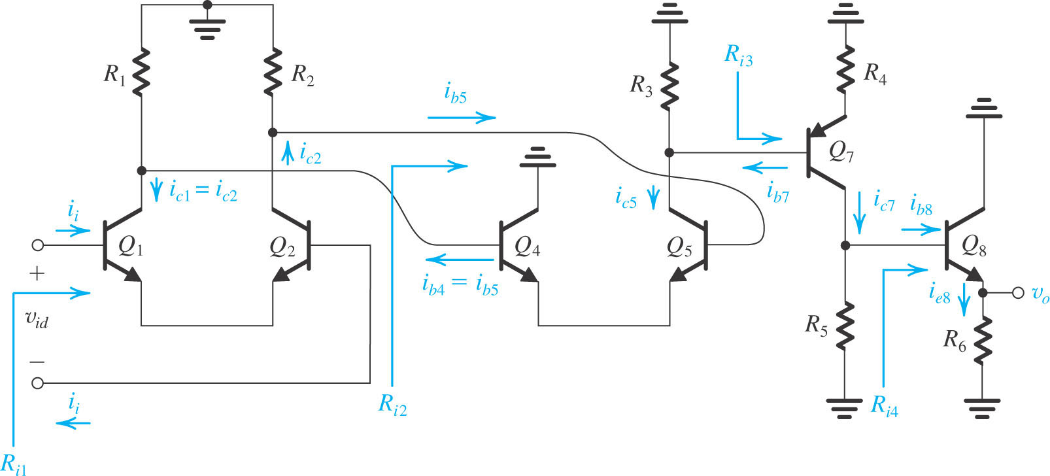

Slide 65
Some examples for further understanding

Slide 66
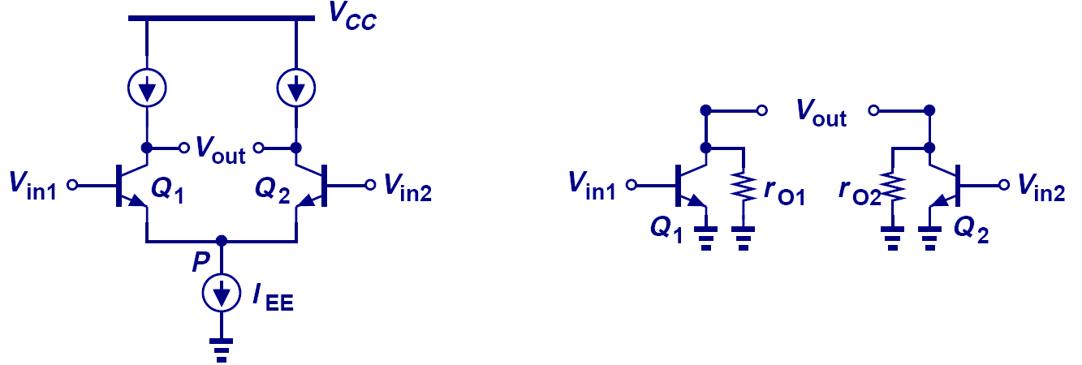
Half Circuit Example 1

Slide 67
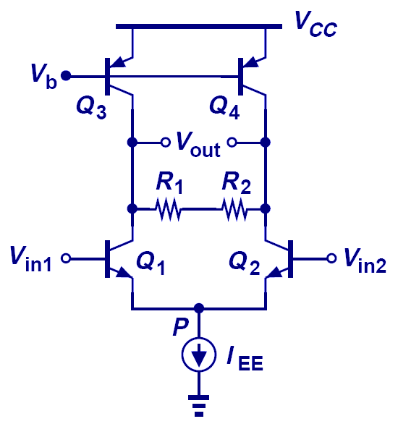
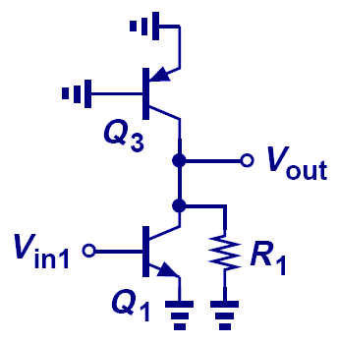
Half Circuit Example 2

Slide 68
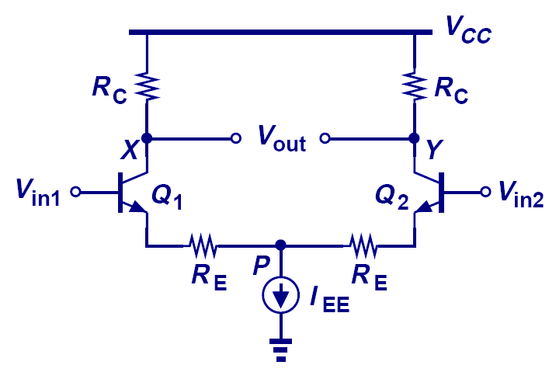
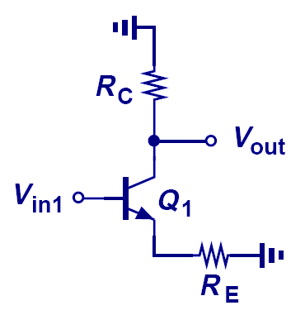
Half Circuit Example 4

Slide 69


Slide 70


Slide 76


Slide 77
Home Assignment
Read chapter no 8 from text book
Understand all solved examples of Chap. 8
Assignment is for your practice, need not to submit it

Slide 78
SUMMARY (MOS & BJT)

